Slide 1

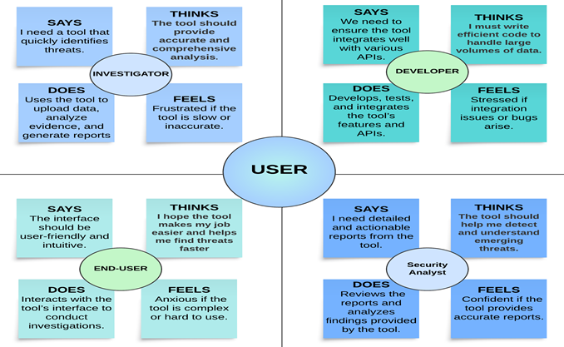
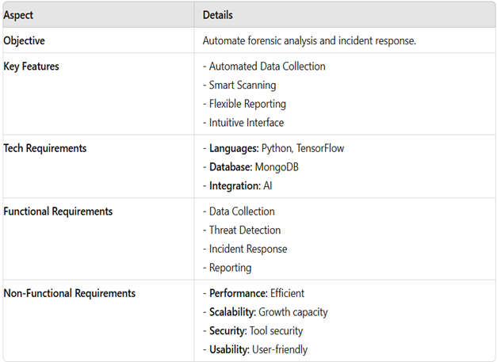
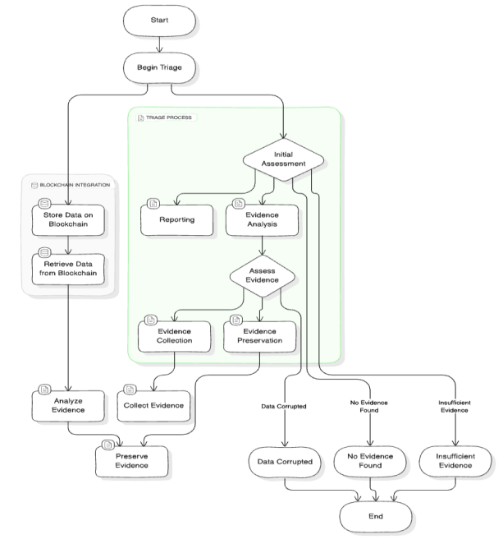
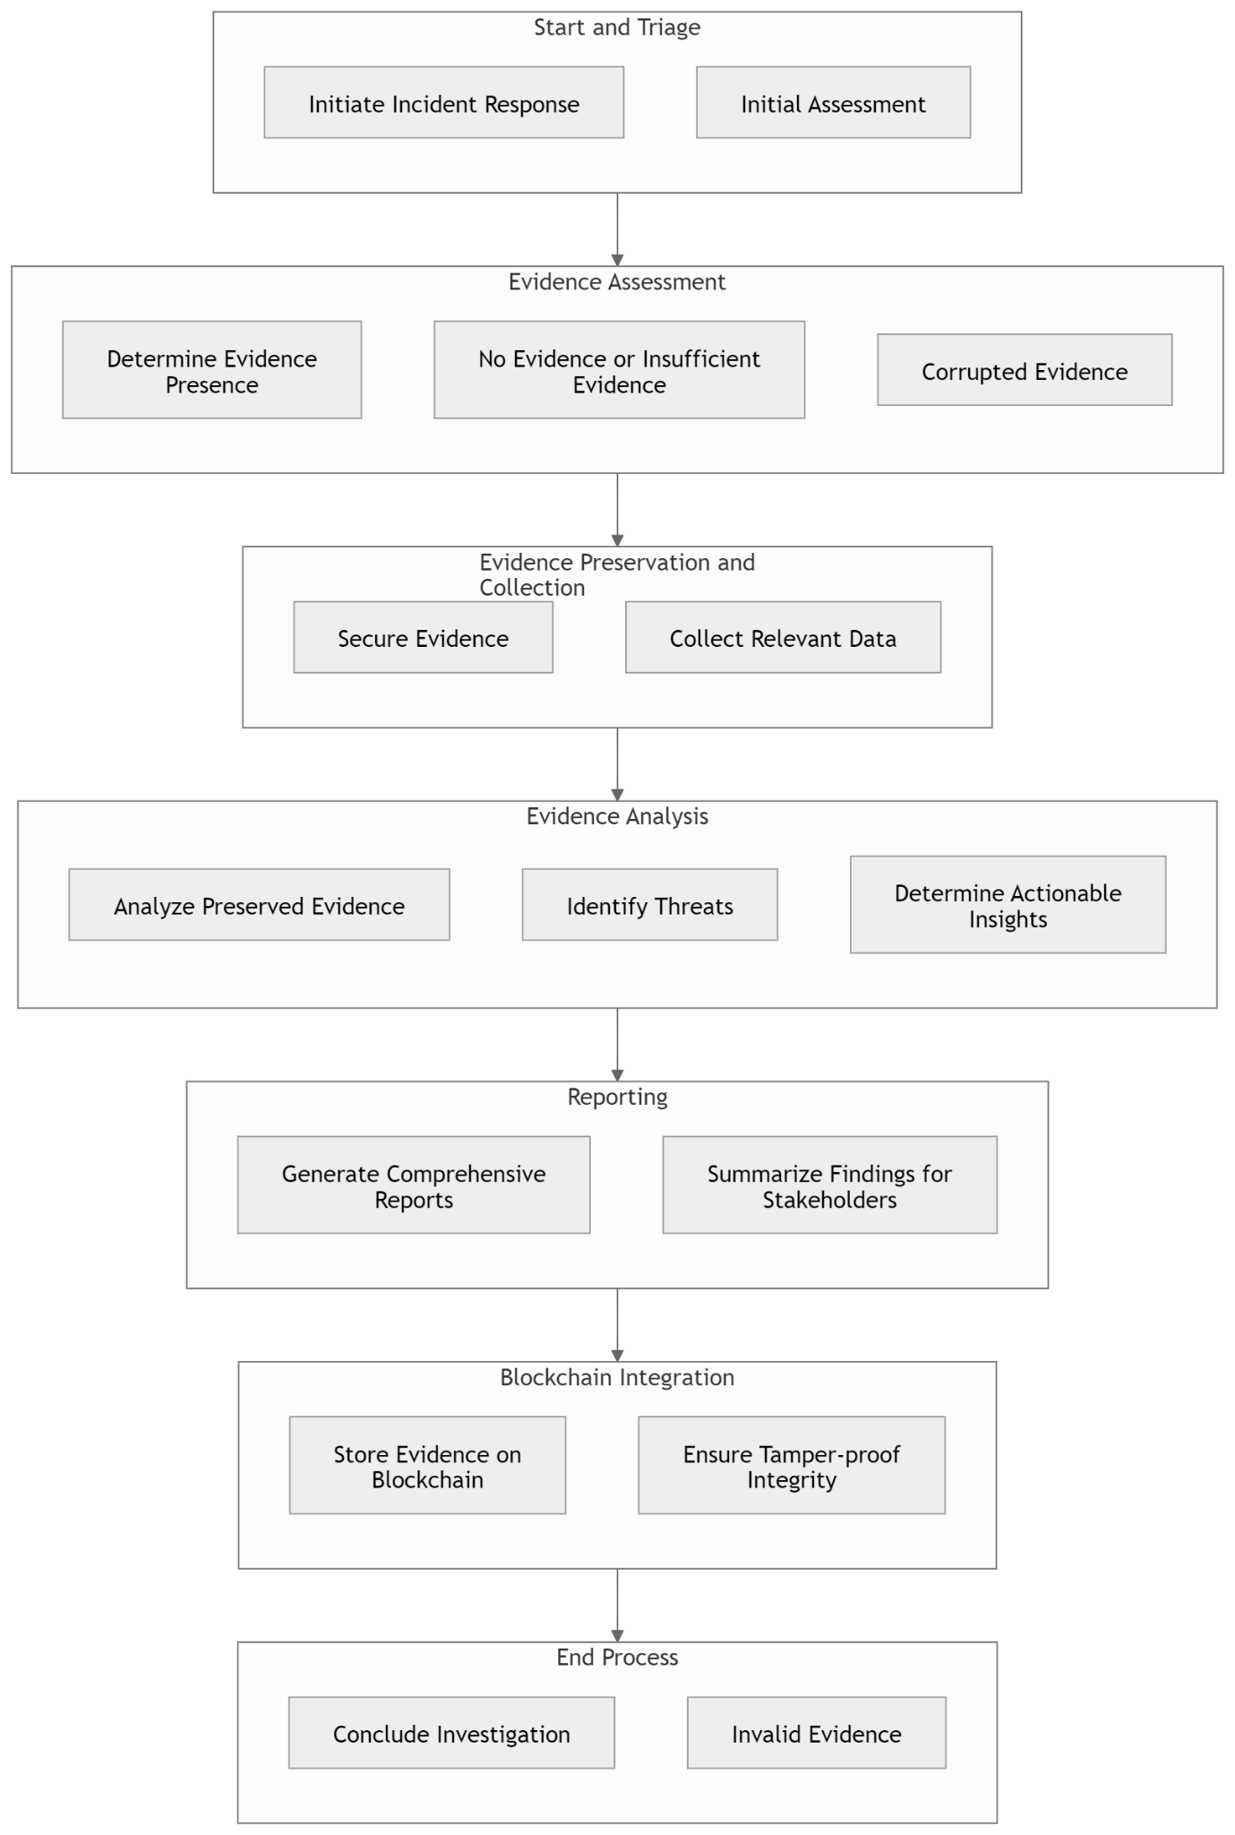
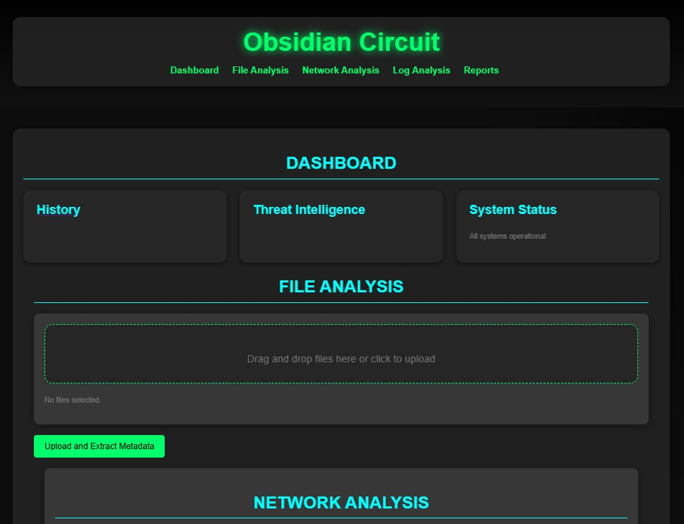
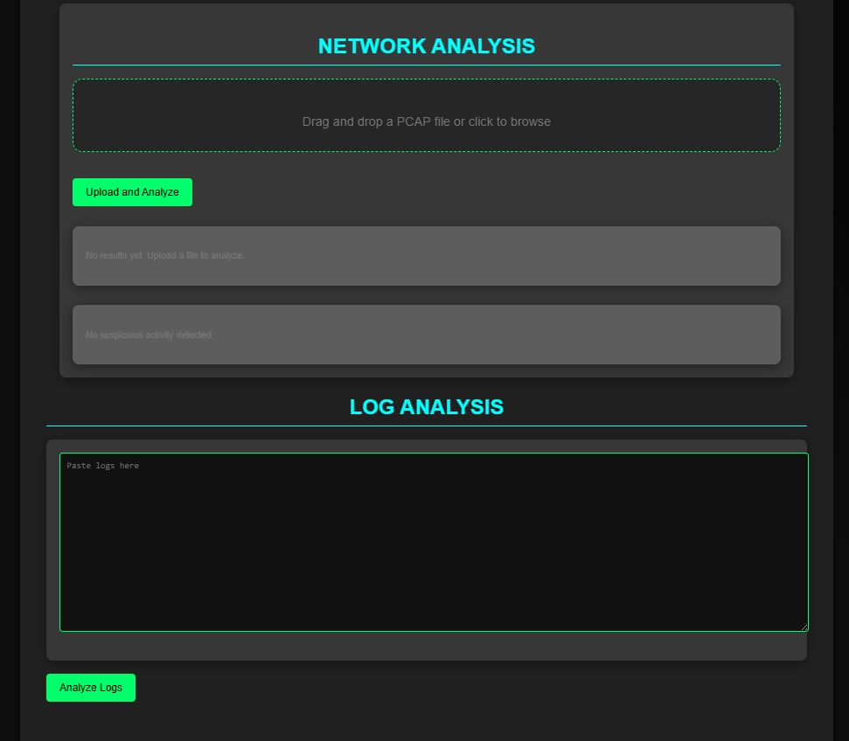
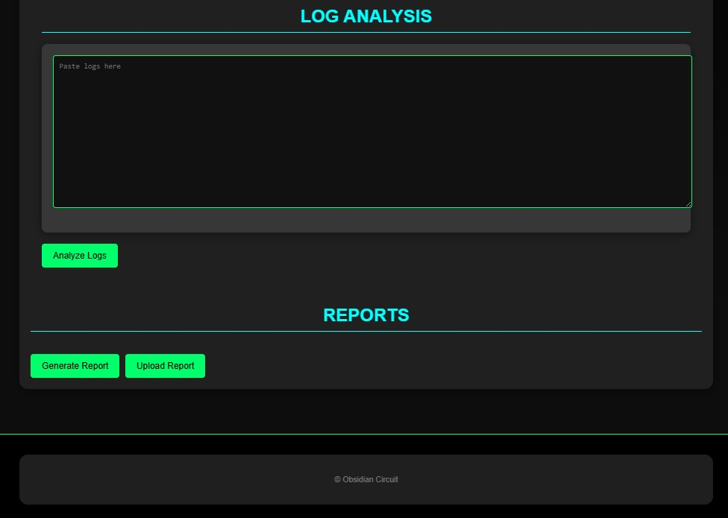

MIT SCHOOL OF COMPUTING
Class : TY-CSF
Group Id: CSE NV-09
DEPARTMENT OF COMPUTER SCIENCE & ENGINEERING
OBSIDIAN CIRCUIT - Harnessing Digital Forensics to Uncover Hidden Threats”
Kathan Somani, Soham Jagtap, Aryan Dsouza, Roque Martins
Faculty Guide:
Prof Dr. Prashant Dhotre
Ideation and Design
Empathy Chart
User
Problem statement
Traditional forensic analysis and incident response methods lack the speed and accuracy needed to counter evolving cyber threats. Manual processes are error-prone and inefficient, often missing sophisticated attacks. An automated, AI-driven tool is crucial for improving threat detection and response.
Proposed Solution
The proposed solution is an automated, AI-driven tool that enhances digital forensics and incident response by swiftly detecting threats, analyzing forensic data, and generating actionable reports. This tool streamlines processes, reduces human error, and improves the accuracy and speed of identifying and responding to cyber threats.
Scope and Feasibility
Obsidian Circuit is an advanced DFIR tool that uses Blockchain, IPFS, AI, and real-time threat intelligence to streamline cyber incident response. It ensures tamper-proof evidence handling, automated threat detection, and detailed forensic analysis. With a user-friendly interface and collaborative features, it enhances efficiency and accuracy, enabling teams to respond to threats effectively and confidently.
.
Development and Testing
Abstract/ Project Insights
Methodology / Algorithm
Results and Output Screen
Obsidian Circuit is an innovative Digital Forensics and Incident Response (DFIR) platform designed to address the complexities of modern cybersecurity challenges. By integrating advanced technologies like Blockchain, decentralized storage (IPFS), AI-driven analysis, and real-time threat intelligence, it ensures secure, efficient, and tamper-proof forensic investigations. The platform automates the lifecycle of incident response, from evidence collection to comprehensive reporting, minimizing human error and expediting decision-making. With tools for analyzing metadata, logs, and network traffic, and cross-referencing threat intelligence sources, it offers actionable insights. Its collaborative and scalable design empowers organizations to detect, analyze, and mitigate threats with precision and confidence.
Future Scope:
The future of Obsidian Circuit includes advanced AI for predictive detection, IoT forensics, quantum-safe security, and enhanced scalability via cloud support. It aims to ensure global compliance, offer mobile and AR-assisted interfaces, and automate workflows. By fostering collaboration and integrating cutting-edge technologies, it will adapt to evolving cybersecurity challenges, remaining a leader in digital forensics.
Awards : Idea Spark 2k24 Winners

